Slide 1




CIT Club WEB Wrap UP
Wed 21st November
Mmu Lab A 05
7pm

Slide 2
Today’s
TOPIC

Slide 3
Getting Started
Web Tables AND
Forms

Slide 4


<table>
</table>
CIT CLUB OFFICIALS
NAME | ADM NO. | PHONE | POSITION
VINCENT LETEIPA | CIT-221-068/2017 | 0791047501 | CHAIRMAN
VICTOR OMONDI | CIT-222-045/2017 | 0797817059 | ASS. CHAIRMAN
PURITY NYAKUNDI | CIT-227-028/2018 | 0795139218 | SEC. GENERAL
VINCENT NJENGA | CIT-223-027/2018 | 0796599235 | TRESURER
NEVIS ADHIAMBO | CIT-223-030/2018 | 0705487741 | SECRETARY
www.citclubmmu.co.ke
bit.ly/citclubmmu

Slide 5
Defining an HTML Table
An HTML table is defined with the <table> tag.
Table row is defined with the <tr> tag
Table header is defined with the <th> tag
Table data/cell is defined with the <td>

Slide 6
The look of an HTML table can be greatly improved with CSS

Slide 7
https://www.w3schools.com/css/css_table.asp

Slide 8
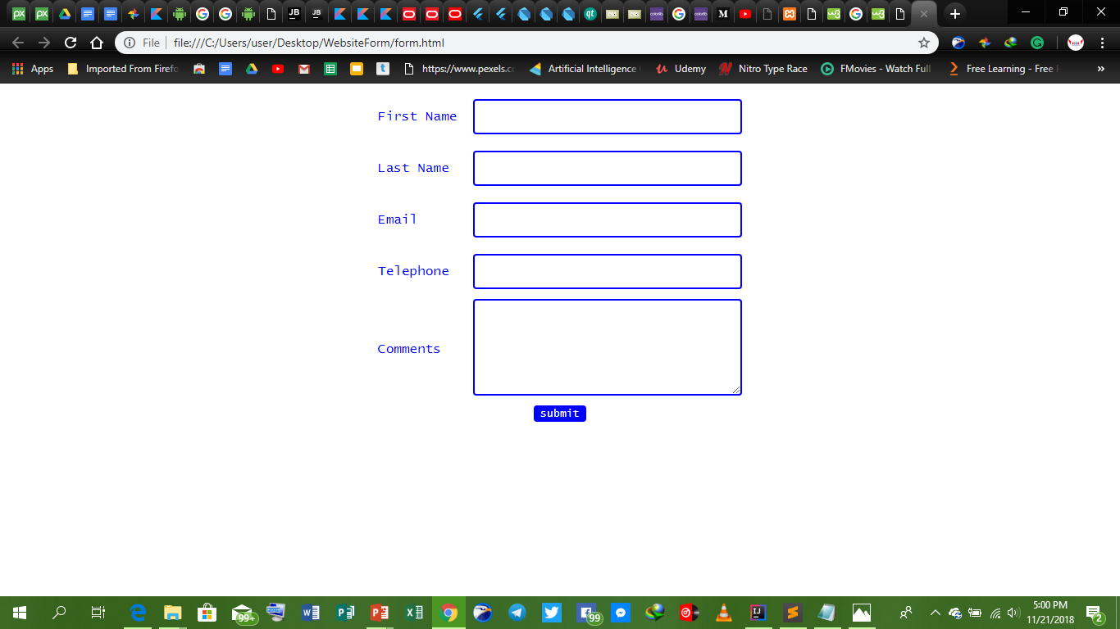
<form></form>

Slide 9
Defining an HTML Form
The HTML <form> element defines a form that is used to collect user input:
<input type="text"> defines a one-line input field for text input:
<input type="radio"> defines a radio button.
Radio buttons let a user select ONE of a limited number of choices:
<input type="submit"> defines a button for submitting the form data to a form-handler.
The action attribute defines the action to be performed when the form is submitted.

Slide 10
https://www.w3schools.com/html/html_forms.asp

